Slide 1
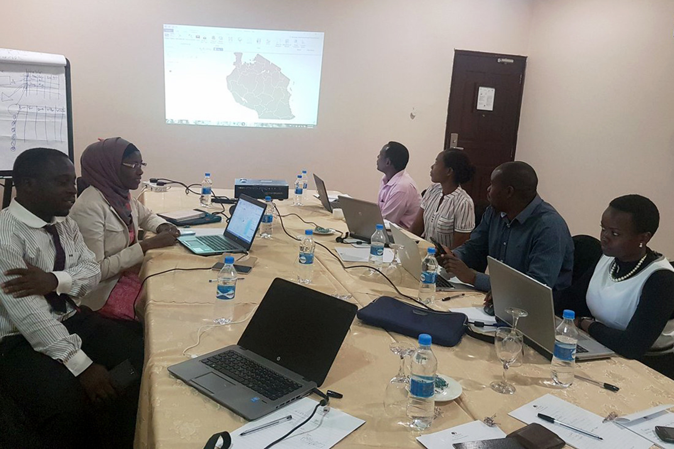
Use of Geographic Information System Mapping for Scaling-Up Voluntary Medical Male Circumcision Services in Tanzania
Kija Nyalali
Catherine Brokenshire-Scott
IntraHealth International

Slide 2
Increasingly Ambitious VMMC Targets
Finding uncircumcised men is challenging in a country where PEPFAR
has supported 3,380,984 circumcisions since 2011
Percentage uncircumcised men in Lake Zone
Mara | 9.5
Mwanza | 22.4
Geita | 33
Shinyanga | 52.5
Simiyu | 53
Mean | 34.08

Slide 3
STORY-GATHERING TIMELINE
THE PROCESS
NBS 2016: ward level male population projections
RESULT
Health facility geo-coordinates (from HFR)
THMIS 15/16: VMMC prevalence to determine VMMC gap to reach 80%
Visual maps of Districts/Wards with large concentration of uncircumcised men
Visual maps of Wards to be targeted for VMMC campaigns
Wards geo-coordinates (from HFR)
Topographical maps (shape files)
Narratives from local community experts (social mapping)
PEPFAR & DHIS2: cumulative MCs performed and expected gaps
Layered with population data in GIS
IMPORTED IN GIS
Notes:
Our planning process starts with thinking through the story or stories you want to tell and specifying which audiences you need to reach ahead of time. This will help guide your decisions about everything, including from what angles to tell your stories, who your audience will likely be, where you might pitch them to, etc.
That Get On the Ground part right there in the middle, it takes a lot to get to that point and a lot of work afterwards. And our team in Chapel Hill doesn’t get to travel very often, so that part also applies to our country colleagues who we work with to gather stories. When we do get to take a storygathering trip, we plan out it out well in advance so we can maximize the time we do have. And during the planning phase, we suggest booking a photographer if you can.

Slide 4
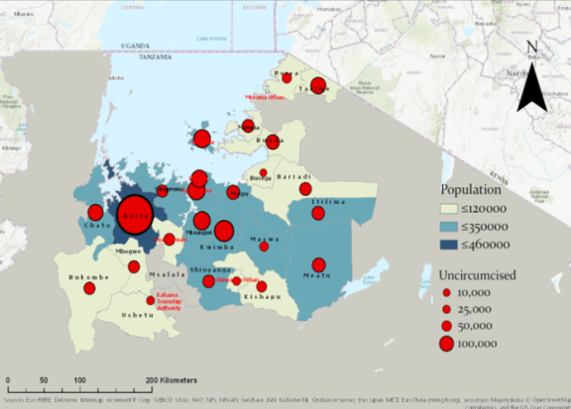
Findings
Over 61% of uncircumcised men were located in 40% of the wards
Triangulated narratives from community experts identified hotspots where men congregate
Pockets with non-circumcising communities within traditionally circumcising SNUs e.g. presence of Wasukuma in Musoma DC
Notes:
Coupled with qualitative information from community experts; interactive GIS mapping ensures efficiently planning, executing and monitoring high impact large scale VMMC interventions with more efficient expenditure
Project designs should consider using interactive GIS maps to make strategic decisions for targeted high impact interventions
Population projections and shape files for Tanzania from regional, district (SNU) and ward level are available through the NBS website. Geo-coordinates for more than 80% of health facilities in Tanzania are all available through the national health facility registry, the remaining are available in DATIM

